Slide 1

DIVORCE PREDICTION
Department of Computer Application and Engineering
GLA University, Mathura
Presented By :
Tushar Gupta – 181500760
Yash Vardhan Gautam - 181500830

Slide 2

TABLE OF CONTENT
Problem Statement
Objective
Gantt chart
Workflow Diagram
About Dataset
Implementation

Slide 3
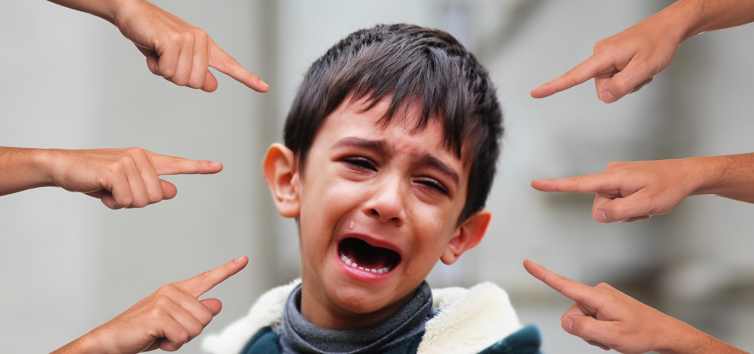
PROBLEM STATEMENT
Graph of Divorce all over the world is increasing year after year.
Divorces in a family has a adverse affect on not only the couple but their family also.
Separation leads to strong negative consequences on the physical as well as psychological health.
Child with a single parent proves to be mentally weak .

Slide 4

OBJECTIVE
In this project we are going to analyse the major factors that lead to failed marriages.
Analysing how one factor is more dominant then other.
Our aim is to create a Divorce Predictor Scale that will predict the likeliness of separation using various machine learning algorithms

Slide 5
GANTT CHART
Identify research area
Jul 15 - Jul 22
Formulate research strategies, research design
Jul 21 - Aug 1
Write Research Proposal
Jul 30 - Aug 20
Data collection
Aug 21 - Sep 2
Data analysis
Sep 1 - Sep 14
Algorithm implementation and visualization
Sep 10 - Sep 30
Write key point for Research paper
Oct 1 - Oct 15
Finalize research
paper writing
Oct 13 - Nov 05
2020
Jul
Aug
Sep
Oct
Nov
2020

Slide 6
Workflow Diagram
Realtime dataset through google form
Find Most common factors that led to divorce
Merging and filtering dataset
Divorce Dataset
From Kaggle
Find least common factors that led to divorce
Splitting Dataset into train and test set
Chances to stop divorce
Applying various classification Algorithms

Slide 7
ABOUT DATASET
Dataset contain 53 attribute represents 53 different question related to marriage.
Dataset Contains 53 factors and each factor’s answer is divided into 5 level accordingly.
Strongly Agree
Agree
Neutral
Disagree
Strongly Disagree
2
1
0
3
4

Slide 8
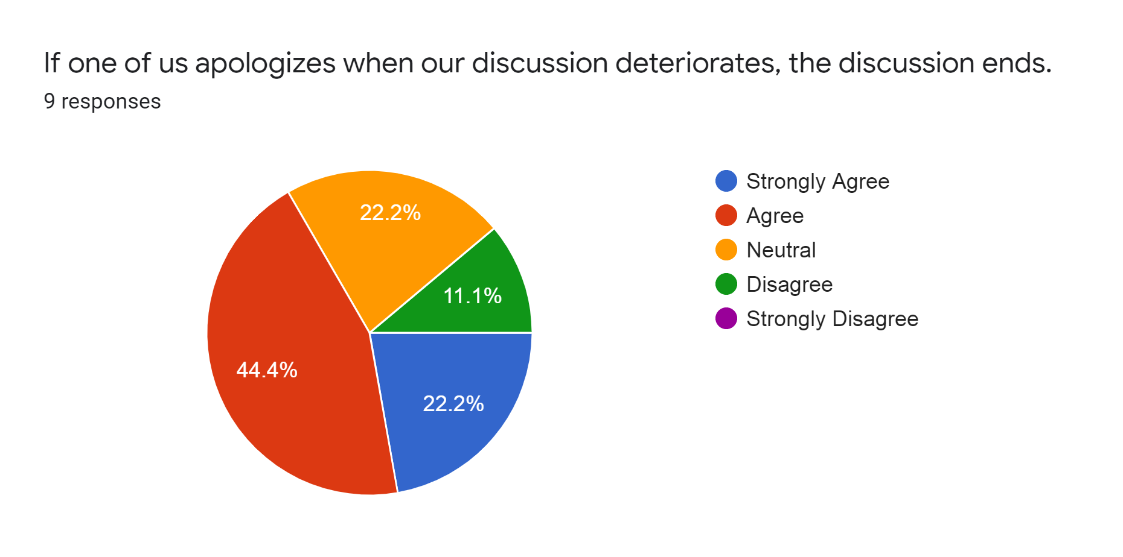
ABOUT DATASET
To analyze the problem at ground level we generate a google form.
Google form contains 6 questions that represents top 6 attributes that responsible for failed marriage.
These 6 factors are determined by using Machine learning algorithms.
Snapshot of one the response on google form

Slide 9
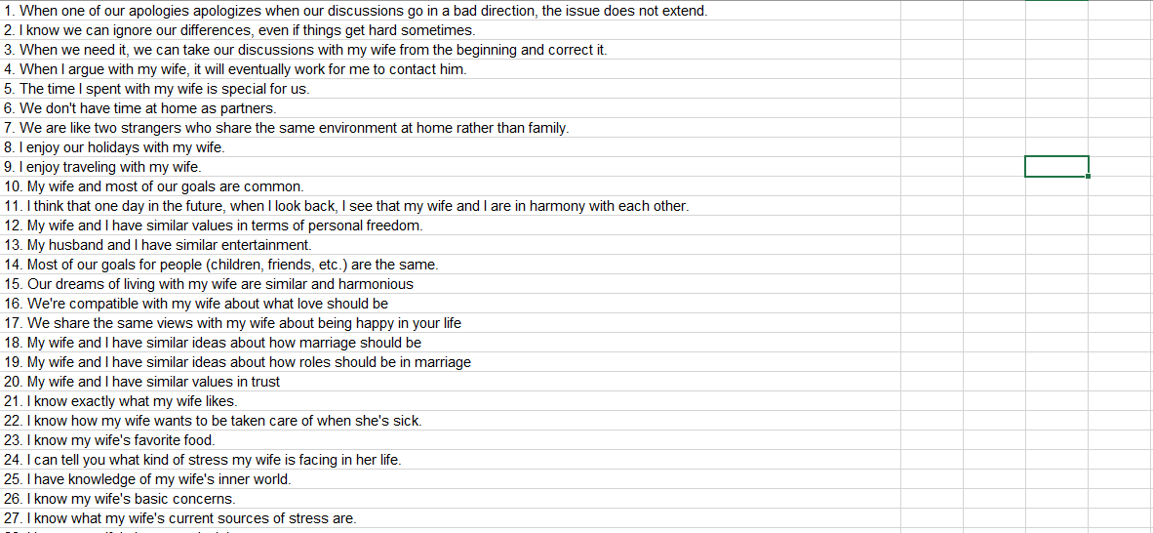
IMPLEMENTATION
Attributes Detail screenshot.
Fig. 1

Slide 10
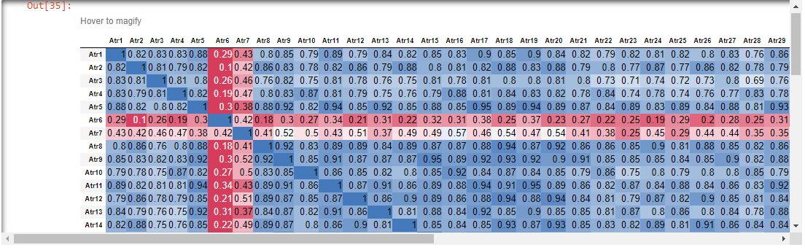
IMPLEMENTATION
Correlation matrix of size 53 x 53 as shown in fig 1..
Fig. 1

Slide 11
IMPLEMENTATION
List of attribute that does not affect the result, which have to be dropped.
15 - Our dreams of living with my wife are similar and harmonious
17 - We share the same views with my wife about being happy in your life
19 - My wife and I have similar ideas about how roles should be in marriage
20 - My wife and I have similar values in trust
28 - I know my wife's hopes and wishes.
29 – I know my wife very well.
36 - I can be humiliating when we argue.
38 - I hate my wife's way of bringing it up.

Slide 12
IMPLEMENTATION
List of attribute on which result depend.
6- We don't have time at home as partners.
7- We are like two strangers who share the same environment at home rather than family.
43- I'm mostly thirsty to calm the environment a little bit.
45- I'd rather stay silent than argue with my wife.
46- Even if I'm right in the argument, I'm thirsty not to upset the other side.
52- I wouldn't hesitate to tell her about my wife's inadequacy.
53- When I discuss it, I remind her of my wife's inadequate issues.

Slide 13
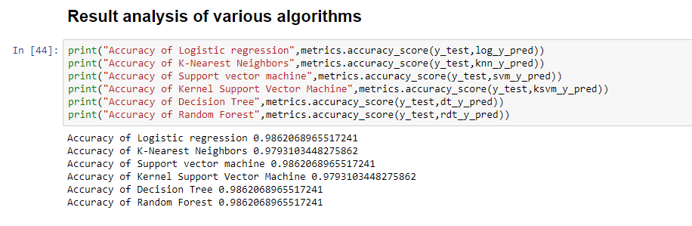
IMPLEMENTATION
Algorithms implemented and their accuracy.
Fig. 2

Slide 14
Thank You

